Slide 1
Intervention Analysis
--By Raul Arevalo, Tianfan Fang, Xiang Li, Shuhan Xie

Slide 2
Agenda
Introduction
- What is intervention analysis?
- Four basic patterns
- Example of intervention
Model description
Conceptual model
Parameters to estimate
Modeling process
Airmiles example in R
Fit the pre-intervention model
Specify intervention
Fit the full model
Model diagnostics

Slide 3
Introduction
What is intervention analysis?
The four basic patterns of intervention model
Examples of intervention model

Slide 4




What is intervention analysis
Intervention analysis is a method that estimates the effect of an external intervention on a time-series.
Notes:
Intervention model, introduced by Box and Tiao, which means a change to a procedure, a law, or a policy, that is intended to change the values of the series. We want to estimate how much the intervention has changed the series.
For example, policy changes, strikes, natural disasters in economic time series: earthquake
the effect of advertisement promotions in business time series:
changes in regulations for environmental time series.

Slide 5
Assumptions:
We always know the intervention before fitting the model.
It can be planned or unplanned.
It only affects the mean level of the series.
We can fit more than one intervention in one model.
Events
Time period
Level change

Slide 6
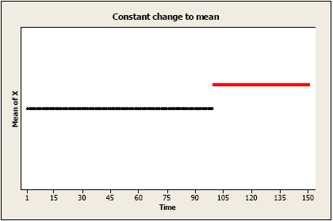
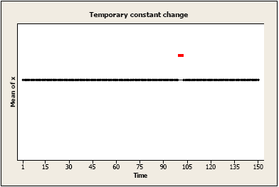
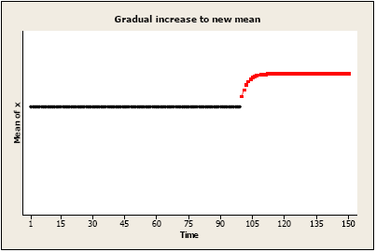
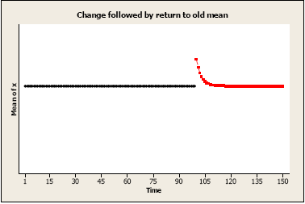
Four basic patterns of intervention model
Source: https://onlinecourses.science.psu.edu/stat510/node/76 PennState STAT 501 9.2 Intervention Analysis
Notes:
Pattern1: Permanent constant change to the mean level: An amount has been added (or subtracted) to each value after time T.
Pattern2: Brief constant change to the mean level: There may be a temporary change for one or more periods, after which there is no effect of the intervention.
Pattern3: Gradual increase or decrease to a new mean level: There may be a gradually increasing amount that is added (or subtracted) which eventually levels off at a new level (compared to the “before” level).
Pattern4: Initial change followed by gradual return to the no change: There may be an immediate change to the values of the series, but the amount added or subtracted to each value after time T approaches 0 over time.
We still have more patterns of intervention model.
For example, suppose that a region has instituted a new maximum speed limit on its highways and wants to learn how much the new limit has affected accident rates. Another example is that a law was published in UK in 1893 that seat belts in the front seat is mandatory, governments want to learn how it changes the injury and death numbers.

Slide 7
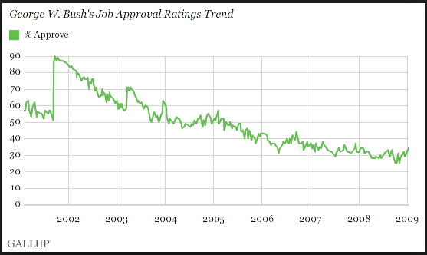
Example
Source:http://www.gallup.com/poll/116500/presidential-approval-ratings-george-bush.aspx
Notes:
The graph shows the time plot of monthly airline passenger-miles in the United States from January 1996 through May 2005. The time series is highly seasonal, displaying the fact that air traffic is generally higher during the summer months and the December holidays and lower in the winter months.
The 9.11 is the intervention in this case, by analyzing the series, we can measure the impact imposed by the terrorist attach and also identify how the air traffic change overtime after 9.11. From the plot, we can clearly see that it gradually increase after the intervention but does it return to the previous level? That’s a question we can assess by intervention analysis

Slide 8
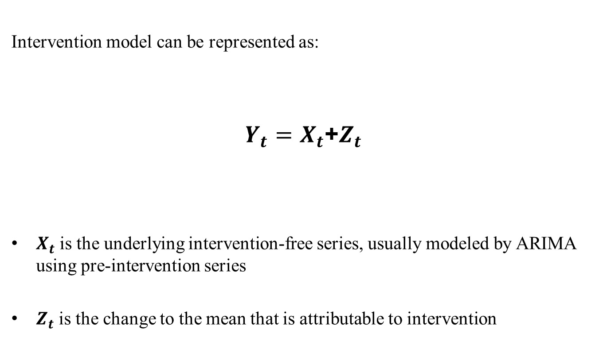
Model Description
Intervention model can be represented as:
$Y_{t}=$ $X_{t}$+$Z_{t}$
$X_{t}$ is the underlying intervention-free series, usually modeled by ARIMA using pre-intervention series
$Z_{t}$ is the change to the mean that is attributable to intervention
Notes:
Two Additive part
Pre-intervention part is modelled by ARIMA function
Explain the format of ARMA model a little bit

Slide 9
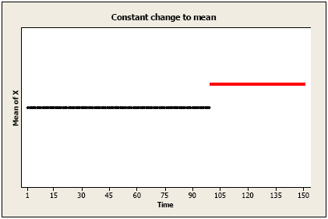
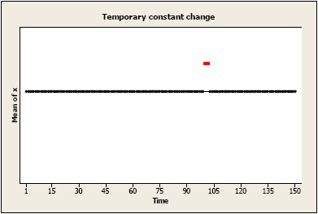
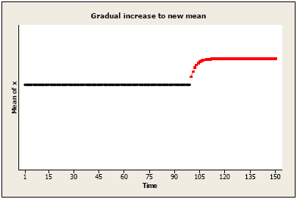
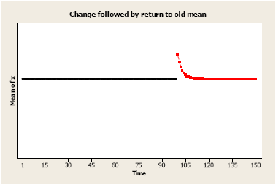
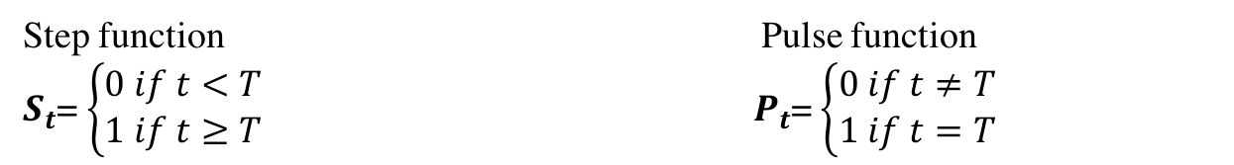
Model Description
Pattern 1 Pattern 2
Pattern 3
Pattern 4
Step function Pulse function
$S_{t}$=$\left\{\begin{aligned}0 if t<T \\ 1 if t≥T\end{aligned}\right.$ ${ P}_{t}$=$\left\{\begin{aligned}0 if t≠T \\ 1 if t=T\end{aligned}\right.$

Slide 10
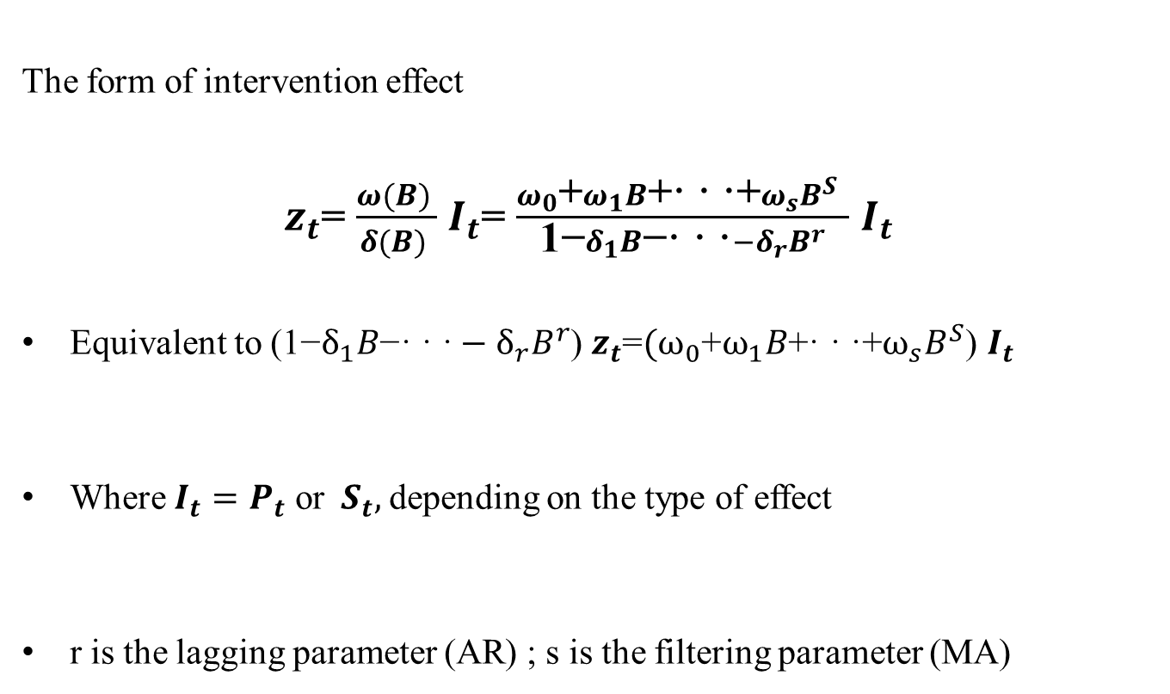


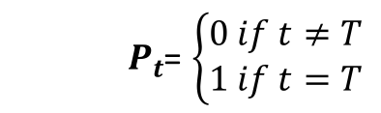

Model Description
$Y_{t}=$ $X_{t}$+$Z_{t}$
The form of intervention effect
$z_{t}$= $\frac{ω(B) }{δ(B) }$ $I_{t}$= $\frac{ω_{0}\text{+}ω_{1}B\text{+· · ·+}ω_{s}B^{S} }{\text{1−}δ_{1}B\text{−}\text{· · ·}−δ_{r}B^{r}}$ $I_{t}$
Equivalent to ($\text{1−}δ_{1}B\text{−· · ·}−δ_{r}B^{r}$) $z_{t}$=${(ω}_{0}\text{+}ω_{1}B\text{+· · ·+}ω_{s}B^{S}$) $I_{t}$
Where $I_{t}=P_{t}$ or${ S}_{t},$depending on the type of effect
r is the lagging parameter (AR) ; s is the filtering parameter (MA)
$(|δ|$<1)
$S_{t}$=$\left\{\begin{aligned}0 if t<T \\ 1 if t≥T\end{aligned}\right.$
${ P}_{t}$=$\left\{\begin{aligned}0 if t≠T \\ 1 if t=T\end{aligned}\right.$
Notes:
Find if this format actually follow the ARMA format
Create a better written expression of the coefficient

Slide 11


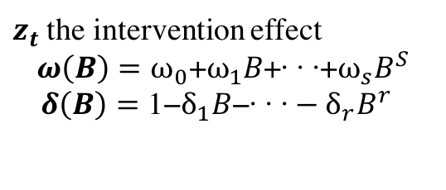
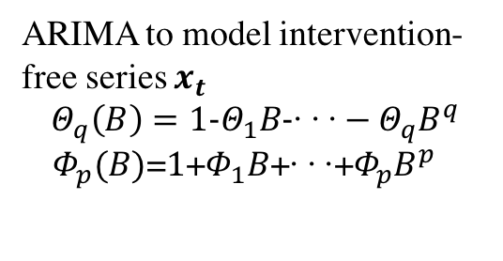
Model Description
Therefore, the general form of model would be
$y_{t}−µ$=$\frac{Θ_{q}(B)}{Φ_{p}(B)}a_{t}+\frac{ω(B) }{δ(B) }I_{t}$
$$Φ_{p}(B)x_{t}=μ+Θ_{q}(B)a_{t}$$
$z_{t}$ the intervention effect
$$ω\left(B\right)=ω_{0}\text{+}ω_{1}B\text{+· · ·+}ω_{s}B^{S}$$
$δ\left(B\right)=\text{1−}δ_{1}B\text{−· · ·}−δ_{r}B^{r}$
ARIMA to model intervention-free series $x_{t}$
$$Θ_{q}\left(B\right)=\text{1−}Θ_{1}B\text{−}\text{· · ·}−Θ_{q}B^{q}$$
${ Φ}_{p}(B)$=$\text{1}\text{+}Φ_{1}B\text{+· · ·+}Φ_{p}B^{p}$

Slide 12
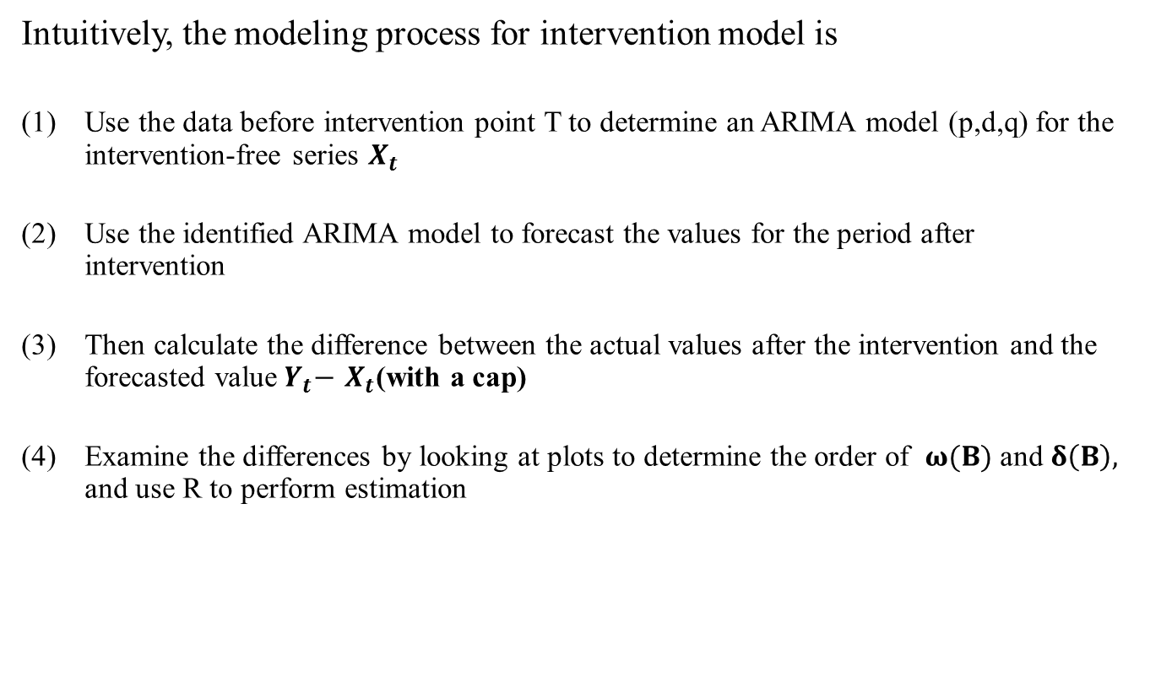

Modeling Process
$Y_{t}=$ $X_{t}$+$Z_{t}$
Intuitively, the modeling process for intervention model is
Use the data before intervention point T to determine an ARIMA model (p,d,q) for the intervention-free series $X_{t}$
Use the identified ARIMA model to forecast the values for the period after intervention
Then calculate the difference between the actual values after the intervention and the forecasted value${ Y}_{t}−$ $X_{t}$(with a cap)
Examine the differences by looking at plots to determine the order of $ω(B)$and $δ\left(B\right),$ and use R to perform estimation
Notes:
Starting from the familiar and the easier part will arouse the interest of listening.
Before getting into the conceptual form of Zt, let’s take a took at four basic intervention pattern

Slide 13

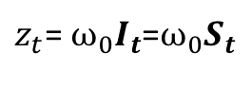
Modeling Process
$z_{t}$= $\frac{ω(B) }{δ(B) }$ $I_{t}$= $\frac{ω_{0}\text{+}ω_{1}B\text{+· · ·+}ω_{s}B^{S} }{\text{1−}δ_{1}B\text{−· · ·}−δ_{r}B^{r}}$ $I_{t}$
Pattern 1: Permanent constant change to the mean level
$z_{t}$= $ω_{0}I_{t}$=$ω_{0}S_{t}$
The difference is constant
Acf and pacf plot of the difference don’t show significance
Notes:
Put a more complete form of model here

Slide 14



Modeling Process
$z_{t}$= $\frac{ω(B) }{δ(B) }$ $I_{t}$= $\frac{ω_{0}\text{+}ω_{1}B\text{+· · ·+}ω_{s}B^{S} }{\text{1−}δ_{1}B\text{−· · ·}−δ_{r}B^{r}}$ $I_{t}$
Pattern 4: An immediate change that eventually return to zero
$z_{t}$=$\frac{ω_{0}}{1−δ_{1}B }P_{t}$
When t<T $z_{t}$=0
When t=T, $z_{t−1}$=0 and ${ P}_{t}$=1, so $z_{t}=ω_{0}$
When t>=T+1, $P_{t}$=0 so $z_{t}={δ_{0}z}_{t−1}$
$z_{t}$-${δ_{0}z}_{t−1}=ω_{0}P_{t}$
$z_{t}={{δ_{1}z}_{t−1}+ω}_{0}P_{t}$
${|δ}_{1}$|<1
Pacf plot of the difference shows cutoff at lag 1
Acf plot would not show any significant lag

Slide 15
Modeling Process
strange.model <-arimax(strange,order=c(1,0,1), xtransf=data.frame(step200=1*(seq(strange)>=200)), transfer=list(c(0,0)))
Arimax command works like the arima, but allows input covariates
Xtransf is to specify where the intervention effect exist
Transfer argument is followed by a list c(r,s), where
r is lagging order=order of AR
s is filtering order=order of MA
Notes:
Introduction of ARIMAX function.

Slide 16
Diagnostics
The diagnostics are the same as ARIMA model
Use the diagnostics plot and Box-Ljung test to see if the residuals are close white noise
Source: https://onlinecourses.science.psu.edu/stat510/node/76 PennState STAT 501 9.2 Intervention Analysis

Slide 17
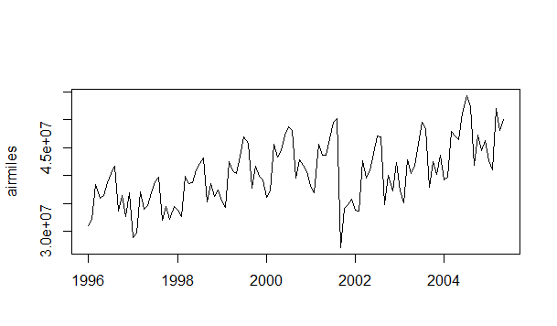
Intervention Analysis in R
R package: “TSA”
Contains command arimax, which is similar to arima but allows for the introduction of covariates.
Drawback: can’t use predict function on an arimax model
Data example: airmiles
Included in “TSA” package
Data set of monthly U.S. airline passenger-miles: Jan 1996 – May 2005
Intervention takes place on September 2001 (9/11 terror attacks)

Slide 18
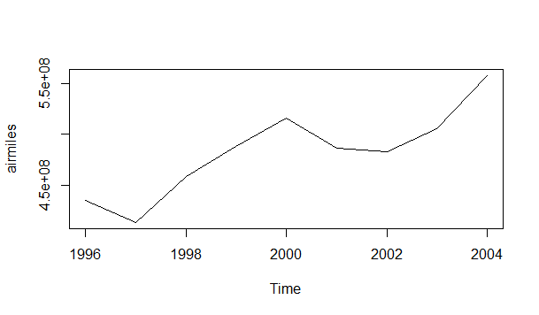
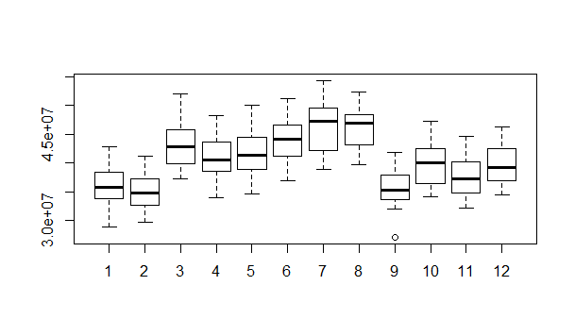
Intervention Analysis in R
Goal of doing an intervention effect
Determine the magnitude of the 9/11 intervention effect
Determine the impact of 9/11 in future travel
What are the components of the original series?
Seasonality and trend
> plot(aggregate(airmiles))
> boxplot(airmiles~cycle(airmiles))

Slide 19
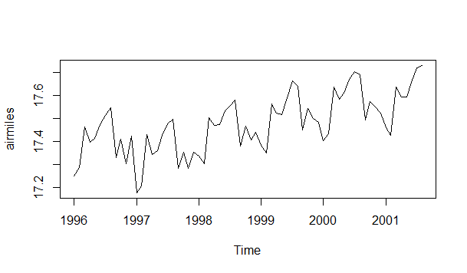
Intervention Analysis in R
Step 1: build a pre-intervention model
Logarithmic form of dataset is used to stabilize variance.
We need to create an ARIMA model using only data pre-9/11
Is the series weakly stationary?
> airl=log(airmiles)
> airl.p=window(airl,end=c(2001,8))
> plot(airl.p)
Notes:
Why the p=1, q=1. Looking at the seasonal chapter.

Slide 20
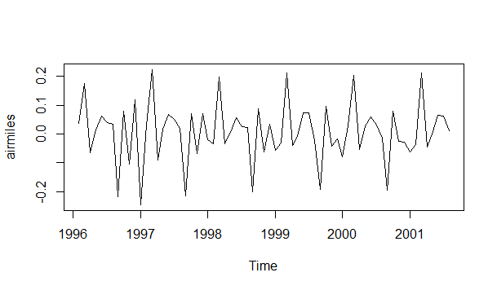
Intervention Analysis in R
Step 1: build the pre-intervention model
We difference the series once (d=1)
We can safely say the series has a constant mean, but it still has a seasonal component.
> plot(diff(airl.p))

Slide 21
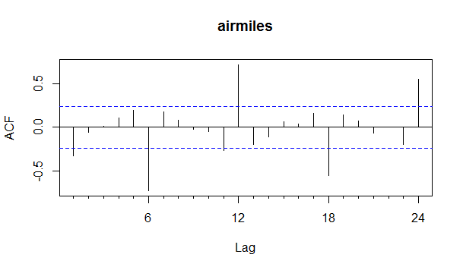
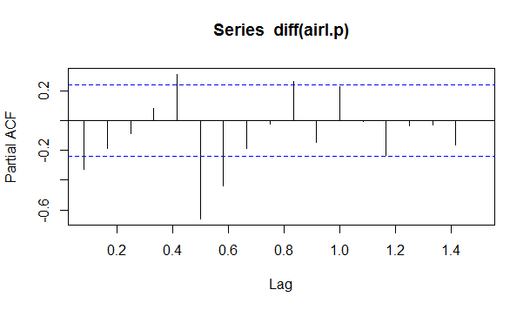
Intervention Analysis in R
Step 1: build a pre-intervention model
We have a complex ACF and PACF structure with seasonality. We will try fitting an airplane model, which tends to fit many situations well (we saw this model in class)
> Acf(diff(airl.p))
> pacf(diff(airl.p))

Slide 22
Intervention Analysis in R
Step 1: build a pre-intervention model
Airplane model: ARIMA (0, 1, 1) x (0, 1, 1)¹²
> air.m0=arima(airl.p,order=c(0,1,1),seasonal=list(order=c(0,1,1),period=12))
> air.m0
Call: arima(x = airl.p, order = c(0, 1, 1), seasonal = list(order = c(0, 1, 1), period = 12))
Coefficients:
ma1 sma1
-0.5006 -0.5709
s.e. 0.1091 0.2298
> tsdiag(air.m0)
Diagnostics:
Both coefficients are significant (Coef. / SE <= -2)
Standardized residuals are homoscedastic
Residuals are not auto-correlated (ACF plot, Box-Ljung test)

Slide 23
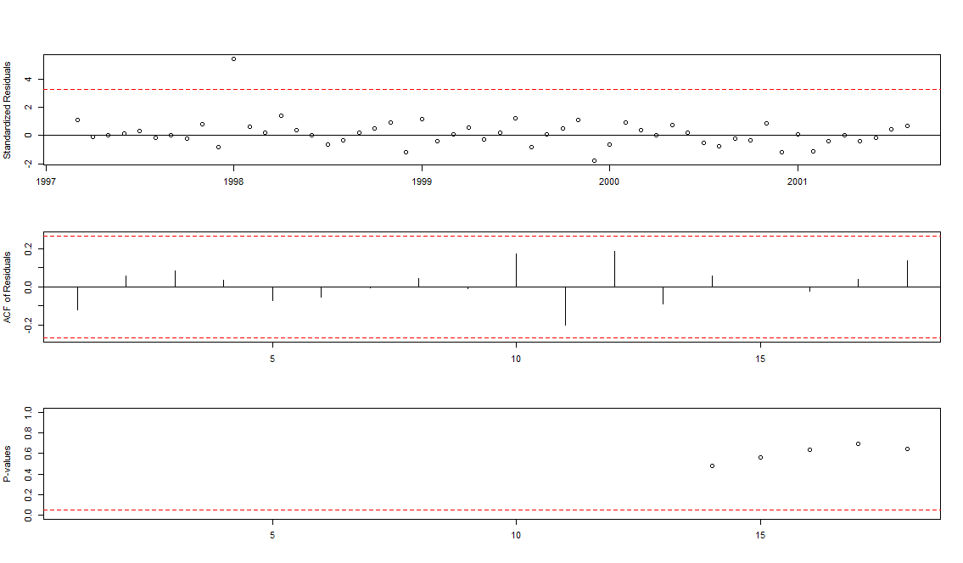

Intervention Analysis in R

Slide 24
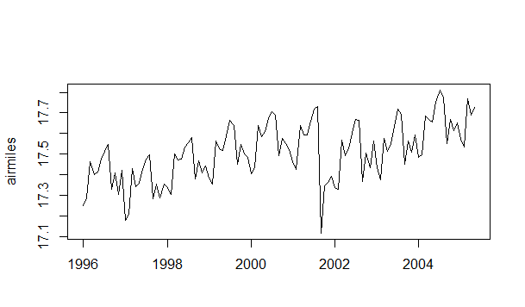
Intervention Analysis in R
Step 2: specify the intervention
Immediate effect happens on September 2001
Lingering effect for some periods after September 2001
A pulse effect should be modeled because the change in mean is not permanent.

Slide 25


Intervention Analysis in R
Step 2: specify the intervention
The form of our time series follows Basic Pattern 4:
Conceptually written as:
Immediate effect: $ω_{0}$ ← constant
Lingering effect: $δ_{1}$← follows an AR(1) process

Slide 26
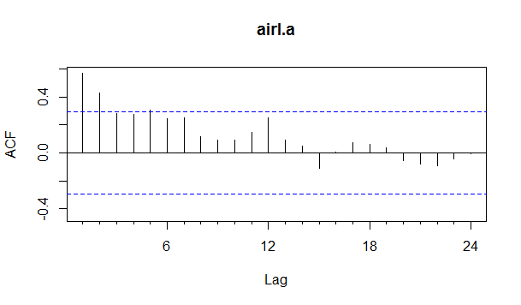
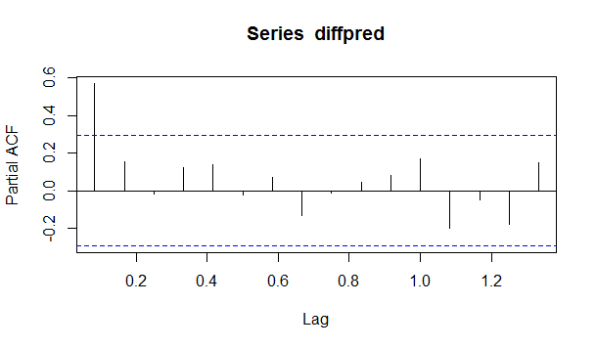
Intervention Model in R
Another possible approach to this:
Use pre-intervention model to forecast rest of time series
Fit a second ARIMA model to the difference between real time series and forecast and then combine both models.
An auto.arima command would give the (1, 0) order model of the intervention, but does not include the constant parameter.
> forecast=predict(air.m0,45)
> plot(forecast$pred)
> airl.a=window(airl,start=c(2001,9))
> diffpred=airl.a-forecast$pred
> Acf(diffpred)
> pacf(diffpred)

Slide 27
Intervention Analysis in R
Step 2: specify the intervention
> s11=1*(seq(airl)==69)
> s11
[1] 0 0 0 0 0 0 0 0 0 0 0 0 0 0 0 0 0 0 0 0 0 0 0 0 0 0 0 0 0 0 0 0 0 0 0 0 0 0 0 0
[41] 0 0 0 0 0 0 0 0 0 0 0 0 0 0 0 0 0 0 0 0 0 0 0 0 0 0 0 0 1 0 0 0 0 0 0 0 0 0 0 0
[81] 0 0 0 0 0 0 0 0 0 0 0 0 0 0 0 0 0 0 0 0 0 0 0 0 0 0 0 0 0 0 0 0 0
s11: A data frame where the intervention time period = 1, and all others are 0. In this case, this is the 69th time period, September 2001.
Because September 11th happened during one period, we know that this intervention is a pulse.
If modeling a pulse, we use ==
If modeling a step, we use >=

Slide 28
Intervention Analysis in R
Step 3: fit the intervention model
order: Order of the pre-intervention ARIMA model
seasonal: Seasonality of the pre-intervention ARIMA model
xtransf: Basically, a way to mark the time period where the intervention takes place (s11)
transfer: The order of the intervention component(s) of the model
method: ‘ML’ for maximum likelihood
> air.m1 = arimax(airl, order=c(0,1,1), seasonal = list(order=c(0,1,1), period=12), xtransf=s11, transfer=list(c(1,0)),method='ML')

Slide 29
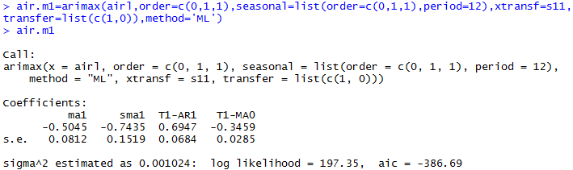
Intervention Analysis in R
Step 4: check model output and diagnostics
All coefficients are significant.
ma1 and sma1 are pre-intervention coefficients
T1-MA0 represents the constant term (immediate effect)
T1-AR1 represents the lingering effect

Slide 30
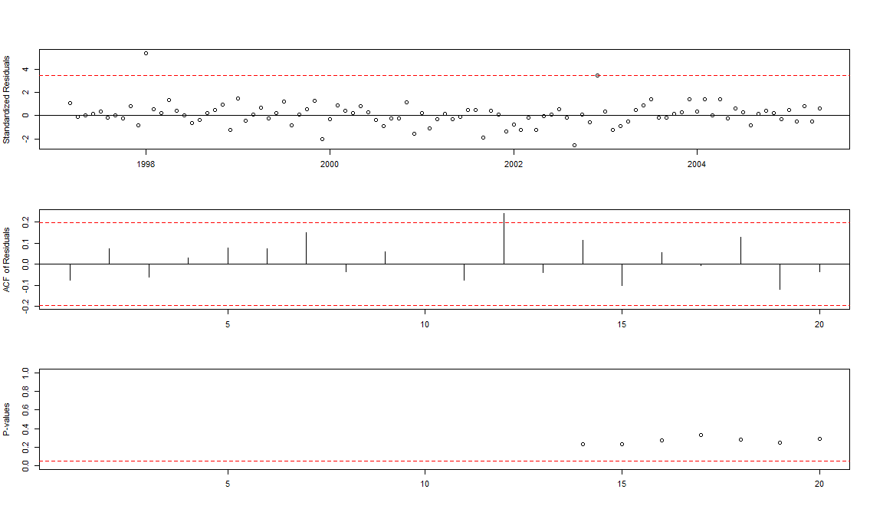

Intervention Analysis in R
Step 4: check model output and diagnostics

Slide 31
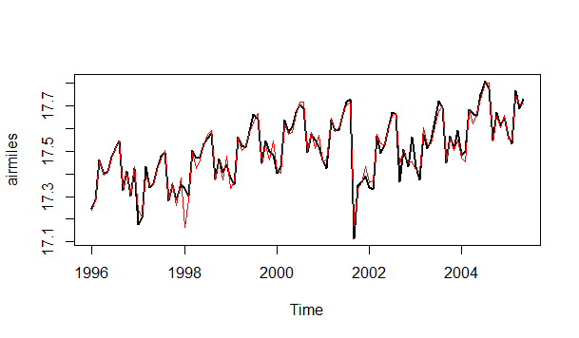
Intervention Analysis in R
Step 5: graph and understand the model
There are some outliers in the original data set, such as December 1996 January 1997 and December 2002. For more accuracy, these can be modeled as intervention effects as well

Slide 32
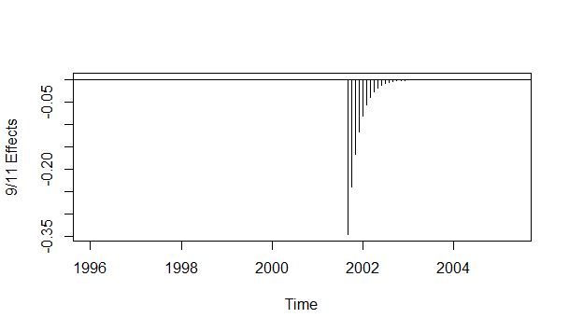
Intervention Analysis in R
Step 5: graph and understand the model
Plot the intervention effects:
> plot(ts(filter (s11, filter=0.6947, method='recursive', side=1) * (-0.3459), frequency=12, start=1996), ylab='9/11 Effects', type='h')
> abline(h=0)
Source: Cryer, Jonathan D., and Kung-sik Chan. Time Series Analysis: With Applications in R. 2nd ed. New York: Springer, 2008. 249-257. Print.

Slide 33

Intervention Model in R
The final model can be written as:
The characters in red represent the intervention in the model.
Model fit is adequate, but more complex models can be fit to minimize the AIC (by modeling a more complex intervention effect and the outliers).
We can conclude (based on the previous plot) that the effect is large on September 2001 but is only temporary, disappearing sometime during early 2003.

